Slide 1
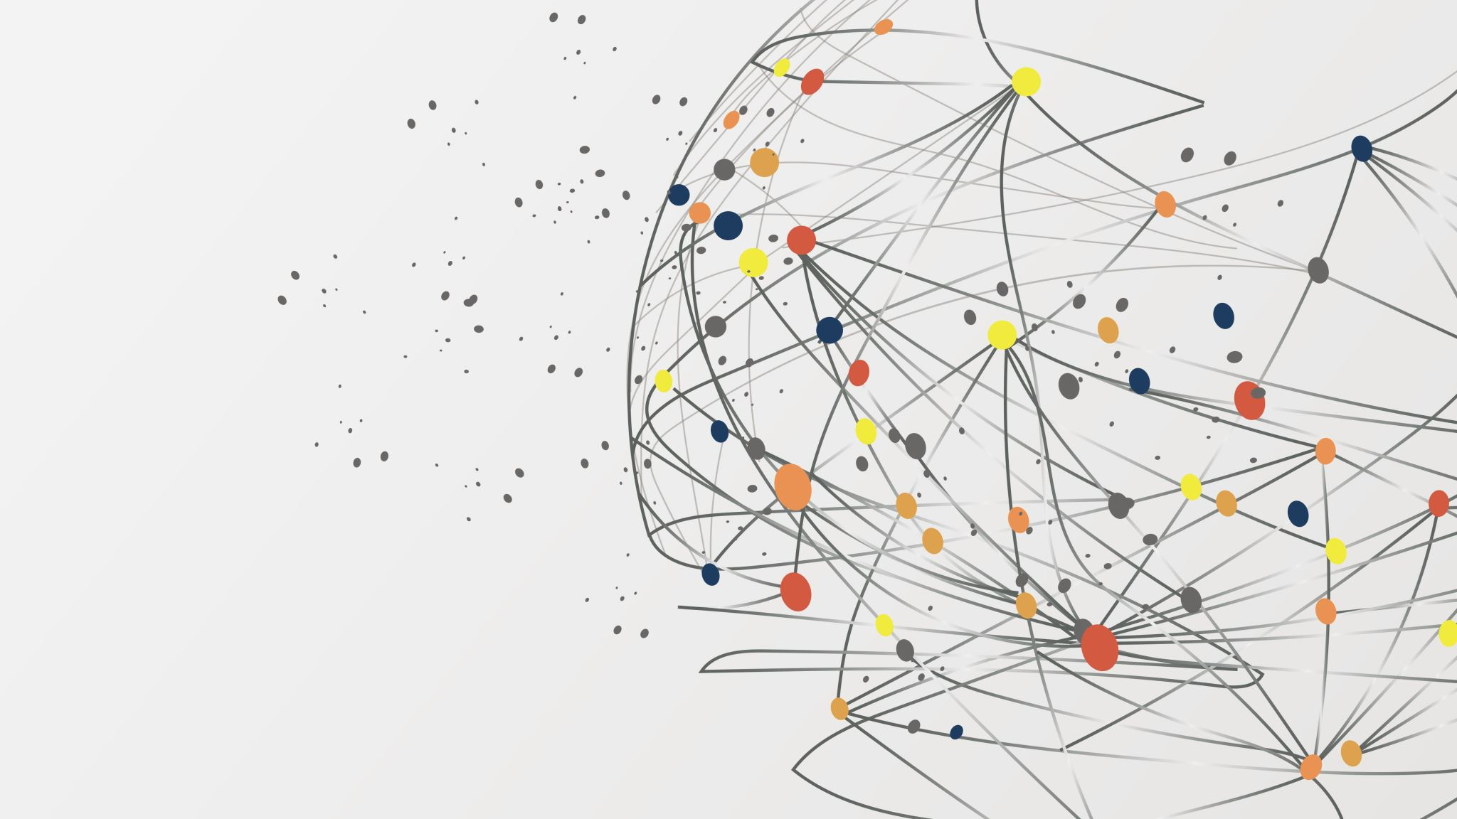
Master Project, IoT-Based Data Analytic Techniques for the Smart Tourism Primary Advisor : Dr. Ahmed Khaled Levent Gumrukcu

Slide 2

What is IOT
Objects cominicate each other thru internet we call it internet of things. These objects are collecting datas and sending datas . These objects can process to data which makes them smart.
Advantages of IOT:
IoT enables companies to automate processes and reduce labor costs. It also provides efficient service to customers.

Slide 3
Advantages :
1. Improved productivity of staff and reduced human labor
2. Efficient operation management
3. Better use of resources and assets
4. Cost-effective operation
5. Improved work safety
6. Thorough marketing and business development
7. Improved customer service and retention
8. Better business opportunities
9. More trustworthy image of the company

Slide 4
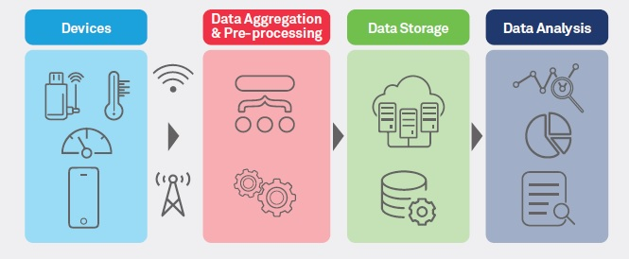
Process
Step 1: . Devices are collecting the data.
Step 2: The data that devices are collect, are in anolog form at this step these datas should be converted to digital form.
Step 3: At this step datas are sending to center or Cloud for storage.
Step 4: At this step we analyze the data with using data analytic tecniques , machine learning and also AI for effective decision making.

Slide 5

Health care IN Iot
IoT provides multiple benefits to the healthcare industry. Doctors, nurses utilize IoT devices in so many ways.
1. Remote patient monitoring
2. Glucose monitoring
3. Heart-rate monitoring
4. Hand hygiene monitoring
5. Depression and mood monitoring
6. Parkinson’s disease monitoring
7. Robotic surgery
8. Connected contact lenses
9. Ingestible sensors

Slide 6

Why security matters for IoT in healthcare
Security is very important in IoT for healthcare, critical security challenges must be addressed.
IoT device developers must secure the data collected by IoT devices. Because those are containing custumers special informations.
IoT devices could be used as gateways for stealing sensitive data if not properly secured. Indeed, 82 percent of healthcare organizations report having experienced attacks against their IoT devices.

Slide 7
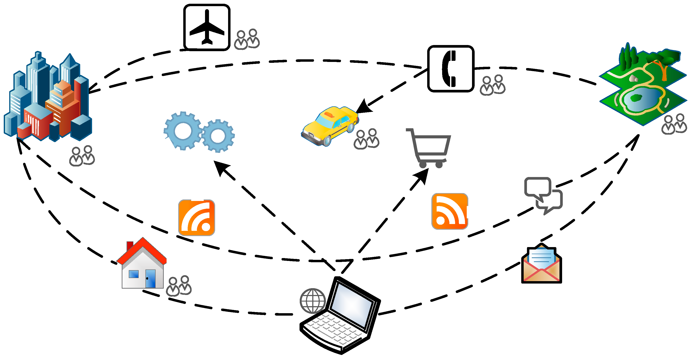
Smart tourism IN IOT
The tourism industry is one of the early adopters of Internet of Things (IoT) technology, using it to improve customer service, provide better experiences for travelers, and create new opportunities for businesses.
IoT helps the tourists with several aspects of a destination, like accommodation, transportation, food and beverage, attractions, etc.
As IoT collects data in real-time, it helps to boost user experience significantly. Furthermore, the tourist’s data is used to enhance the travel experience by giving various suggestions and helping them out with all their needs at any hour.
Numerous applications are applied to tourism, such as chatbots, ranking hotels based on user ratings via machine learning, AR and VR to visit the place virtually, and the list continues.

Slide 8
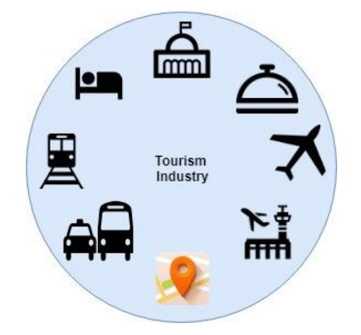
Some Applications In Smart Tourism
-Autonom trains
-Flying safer and more efficiently with IoT
-The next-generation airbus is coming up with 10,000 sensors on the wing
-Helping tourists to find best destinations
-Streamlining hotel operations
-Smarter intercity traveling with IoT(smart cities)

Slide 9

Data analytıc tecnıques ın ıot for smart tourısm
Affinity Propagation
Agglomerative Clustering
Bibliometric analysis
Birch clustering
Dbscan clustering
KMeans clustering
Mean shift clustering
Multiple Linear Regression

Slide 10
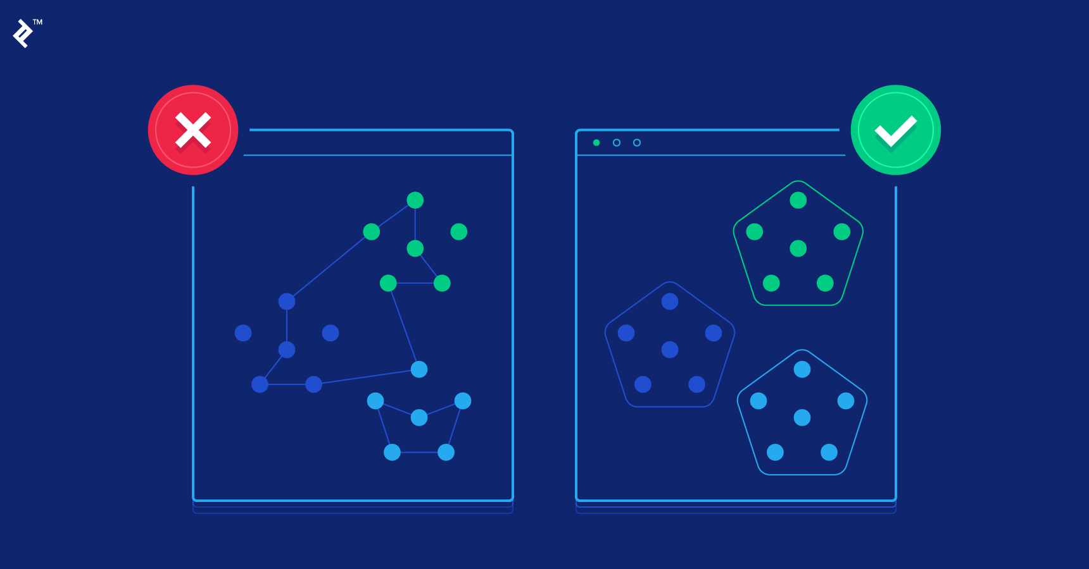
1. Affınıty propagatıon
Affinity Propagation (AP) is a clustering algorithm that aims to identify exemplars among data points. An exemplar is a data point that is representative of a cluster.
How it works:
Similarity Matrix: For each pair of data points, compute the similarity. Typically, the negative squared distance is used as the similarity measure. The more similar two points are, the higher the value will be.
Responsibility and Availability: These are two matrices introduced by the algorithm.
Responsibility (r(i,k)) reflects the suitability of data point k to serve as the exemplar for i, relative to other potential exemplars for i.
Availability (a(i,k)) reflects the extent to which point i chooses k as its exemplar, taking into account other points' preference for k as an exemplar.
Iterative Message Passing: The algorithm proceeds by iteratively updating the responsibility and availability matrices.
Responsibility update: r(i,k) = s(i,k) - max{a(i,k')+s(i,k')} for all k' not equal to k.
Availability update: a(i,k) = min{0, r(k,k) + sum(max{0, r(i',k)})} for all i' not equal to i.
Deciding Exemplars: After several iterations, the algorithm converges, and exemplars for each data point can be found by combining the responsibility and availability matrices.

Slide 11

Advantages:
No need to specify the number of clusters: The algorithm itself will determine the number of clusters based on the data.
Can find clusters of different shapes: Unlike K-means, which is generally suitable for spherical clusters, AP can find clusters of various shapes.
Disadvantages:
Computationally intensive: Due to the message-passing mechanism and the handling of matrices, the algorithm can be more computationally demanding than some other clustering methods, especially for large datasets.
Sensitive to preference parameter: There's a "preference" parameter that impacts the number of exemplars. If not set properly, it can yield too many or too few clusters.

Slide 12
Applications:
Affinity Propagation can be applied to various domains, including:
Image recognition: For clustering similar images.
Gene expression data: Finding patterns in gene expression datasets.
Recommendation systems: To group similar users or items.
Smart tourism: To group tourist spots based on certain criteria.
Python Library/s :
Scikit-learn (sklearn) : A comprehensive machine learning library, it provides a vast array of clustering methods and utilities for data mining and data analysis.

Slide 13
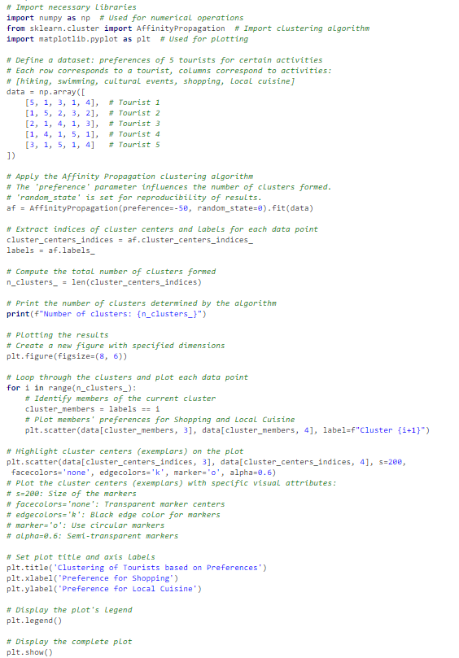
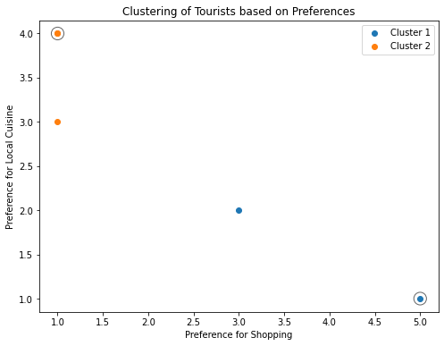
Example
The given hypothetical data presents the preferences of 5 tourists for 5 activities. The preferences are rated from 1 to 5. After clustering, the script plots the preferences for 'Shopping' and 'Local Cuisine' and the clusters they belong to.

Slide 14
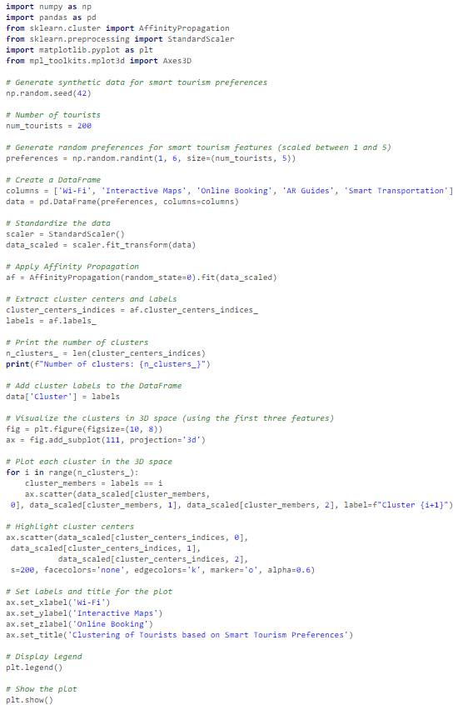
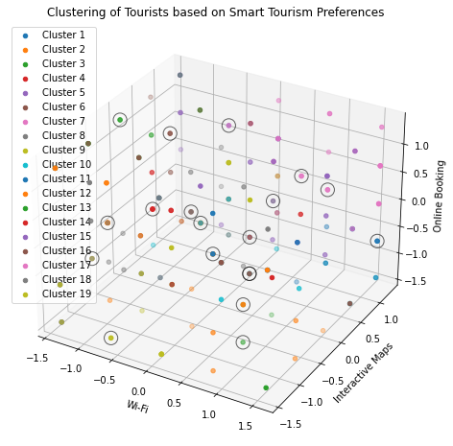
Example 2
We have data about tourists' preferences for various smart tourism features. The features include Wi-Fi availability, interactive maps, online ticket booking, augmented reality guides, and smart transportation. We will use Affinity Propagation to cluster tourists based on their preferences. We have random preferences for smart tourism features for 200 tourists, applied Affinity Propagation, and visualized the clusters in 3D space using the first three features

Slide 15

2.Agglomerative Clustering
This is a type of hierarchical clustering. It begins with each point as a separate cluster and merges them based on a distance measure. This process continues iteratively until all points belong to one cluster or a certain condition is met.

Slide 16

How does it work?
Initialization: Start by treating each data point as a single cluster. This means if there are N data points, we have N clusters at the start.
Agglomeration: In each of the subsequent stages, the two clusters which are closest to each other are merged into a single cluster, which reduces the total number of clusters by one.
Completion: Repeat the process until there is only one single cluster left, comprising all data points. The result can be represented as a dendrogram, a tree-like diagram that shows the sequence in which clusters were merged.
Key Concepts:
Linkage Criteria: This defines the metric used for the merge strategy:
Single Linkage: Minimum pairwise distance. It considers the shortest distance between the two clusters, i.e., the distance between the closest points.
Complete Linkage: Maximum pairwise distance. It considers the longest distance between the two clusters, i.e., the distance between the farthest points.
Average Linkage: Average pairwise distance. It considers the average distance between all pairs of points in the two clusters.
Ward's Linkage: Increase in variance. It merges the two clusters that lead to the minimum increase in total within-cluster variance after merging.
Distance Metric: The metric to compute the distance between data points (e.g., Euclidean, Manhattan, Cosine).
Dendrogram: A tree-like diagram that records the sequences of merges or splits. By cutting the dendrogram at a particular height (distance), one can decide the number of clusters for the data.

Slide 17
Advantages:
It produces a hierarchy of clusters, which can be very informative.
The dendrogram visualization is helpful in understanding the cluster formation.
No need to specify the number of clusters a priori (but we do need to cut the dendrogram at some point).
Disadvantages:
Generally has a high time complexity (e.g., O(N³)) for the naive algorithm, though efficient algorithms exist).
The result might change based on the choice of linkage criteria.
Not scalable for very large datasets.

Slide 18
Applications
Taxonomy formations in biology.
Document clustering and topic hierarchies in text data.
Customer segmentation based on purchasing behavior.
In the context of smart tourism, Agglomerative Clustering can be used to create a hierarchy of tourist attractions based on features like visitor reviews, types of attractions, or proximity. By analyzing the resulting clusters, tourism componies can design tour packages, marketing strategies, or infrastructure development plans.
Python Library/s :
Pandas (pandas): For data manipulation and analysis.
Scikit-learn (sklearn) : A comprehensive machine learning library, it provides a vast array of clustering methods and utilities for data mining and data analysis.

Slide 19
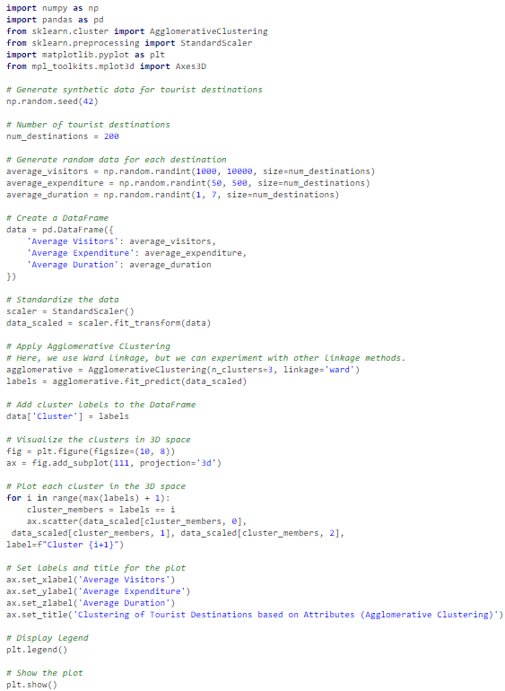
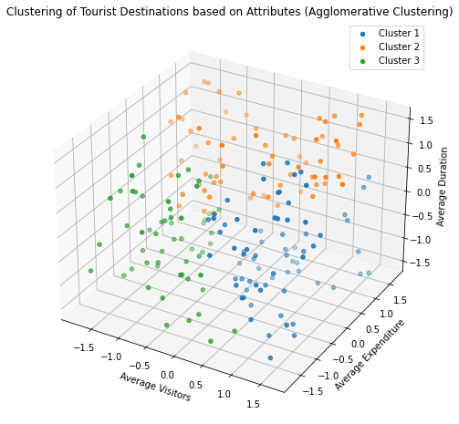
EXAMPLE
Suppose we have tourist destinations, and we've recorded the average number of visitors, the average expenditure of a tourist, and the average duration of the visit for each destination. We want to cluster these destinations based on these attributes:
In this example, tourist destinations are clustered based on three features: the average number of visitors, average expenditure, and average duration. We chose three clusters (n_clusters=3)

Slide 20

3.Bibliometric analysis
Bibliometric analysis is a research method used in library and information science. It involves the statistical analysis of written publications, such as books or articles. The main objective is to quantify the various aspects of publications and provide insights into patterns, structures, and relationships among authors, articles, topics, and journals. It serves as a tool for understanding the dynamics of knowledge production and dissemination in particular fields or disciplines.

Slide 21
Key Consept
Core Components:
Citation Analysis: Examines how often, and by whom, articles or books are cited. It helps identify core journals and seminal works in a particular field.
Content Analysis: Investigates the themes and topics of scholarly communication, often using methods from text mining and natural language processing.
Co-authorship Analysis: Examines patterns of collaboration among researchers.
Journal Analysis: Assesses journals and their impact within the academic community.
Common Metrics and Tools:
h-index: Measures the productivity and citation impact of the publications of a researcher.
Impact Factor: A measure that indicates the average number of times articles from a journal published in the past two years have been cited in a particular year.
Citation Networks: Represent the interlinking of various research articles based on citations.
Co-word Analysis: Helps identify the frequency of co-occurrence of keywords to determine the thematic emphasis in a field.

Slide 22
Applications
Research Assessment: Universities, funding bodies, and other institutions use bibliometrics to assess the impact of their research outputs.
Tourism Research: Analyze research publication patterns in tourism to identify trending topics, influential authors, or emerging destinations.
Trend Analysis: Understand evolving research themes, emerging fields, or declining interests in specific topics.
Discovering Influential Works: Identify seminal papers, authors, or journals in a particular field.
Funding Decisions: Funding bodies can assess the impact and relevance of previous research when making decisions about future funding allocations.
Collaboration Patterns: Understand international collaboration patterns and prominent research groups.

Slide 23
Python Library/s
Pandas (pandas): For data manipulation and analysis.
NetworkX (networkx): To analyze bibliometric networks.
Pybliometrics: Specifically designed for Scopus-based bibliometric research.

Slide 24
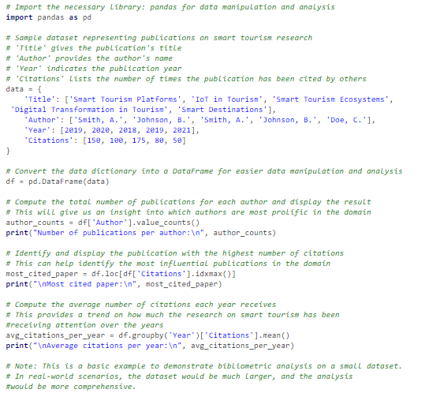
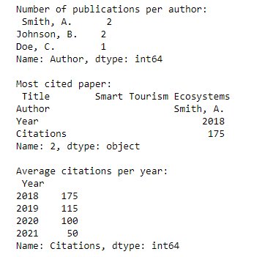
EXAMPLE
In this code, we demonstrates a simple bibliometric analysis, examining the distribution of publications among authors, identifying the most cited paper, and exploring the average citations per year.

Slide 25
Birch clustering
Birch clustering is a type of incremental clustering algorithm designed to handle particularly large datasets. Its primary focus is to incrementally and dynamically cluster incoming multi-dimensional metric data points in an attempt to produce the best quality clustering for a given set of resources (memory and time constraints).

Slide 26

Core Concepts of Birch
Clustering Feature (CF): A triple (N, LS, SS) that summarizes the essential features for a cluster. Here:
N is the number of data points in the cluster.
LS is the linear sum of the N points.
SS is the square sum of the N points.
The CF Tree is a height-balanced tree that stores the clustering features for hierarchical clustering. Each node in the tree contains a set of CFs.
Threshold: This parameter determines how close a point should be to the centroids of existing sub-clusters to be merged into a sub-cluster.
Branching Factor: Determines the number of CF subclusters in each node.
Incremental Clustering: Birch can process one entry at a time, rather than requiring the whole dataset upfront. This makes it suitable for large datasets.

Slide 27
Applıcatıons
Tourist Behavior Analysis: Based on tourist behavior data (like routes taken, attractions visited, money spent, time spent at each location, etc.), clustering can group tourists with similar behaviors. This can help in designing personalized tour packages or marketing campaigns.
Attraction Clustering: Cluster tourist attractions based on various features, such as average number of visitors, types of activities, or reviews. This helps tourism boards decide where to focus their marketing or development efforts.
Review Analysis: By clustering reviews, tourism agencies can identify common sentiments and issues, allowing for targeted improvements.
Seasonal Analysis: Clustering can help identify patterns during different seasons, guiding tourism agencies in resource allocation and event planning.
Optimizing Tourism Operations: Tourism operators can cluster operational data, like transportation schedules, hotel occupancy rates, and event attendances to make informed decisions.

Slide 28
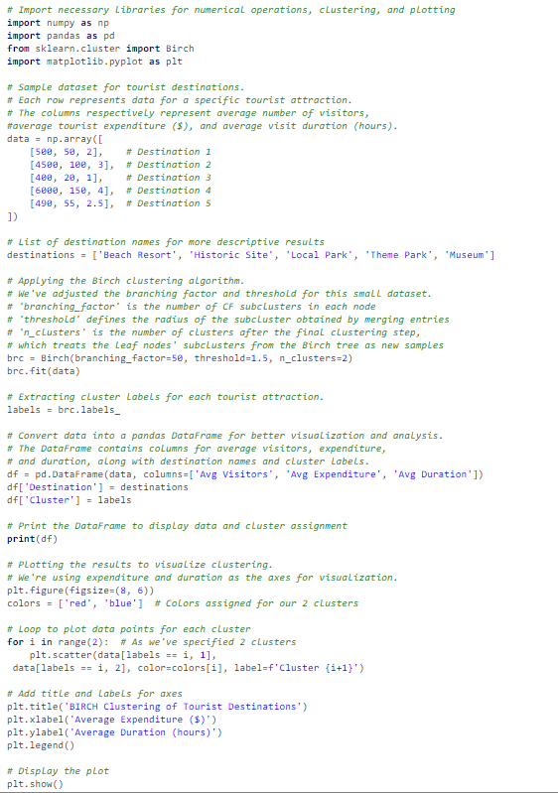
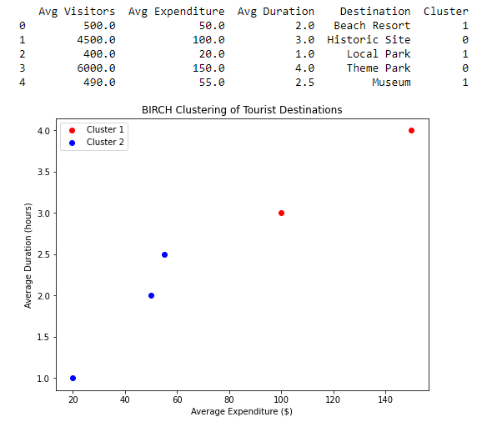
Example
In the context of smart tourism, let's say we have a dataset of tourist attractions, and we've recorded the average number of visitors, the average expenditure of a tourist, and the average duration of the visit for each attraction. We want to cluster these attractions based on these attributes:
This code applies Birch clustering to the tourist destinations based on the average number of visitors, average expenditure, and average duration of the visit. It then visualizes these attractions based on the average expenditure and average duration.

Slide 29
5. Dbscan clustering
DBSCAN relies on a density-based notion of clusters and is particularly well-suited to tasks where the clusters are of similar density. Unlike k-means, which partitions the data into non-overlapping clusters, DBSCAN views clusters as areas of high density separated by areas of low density.
Key Concepts:
Epsilon (ε): This is a distance parameter that defines the radius around a data point. If a sufficient number of other data points fall within this radius, then the original point is classified as a "core" point.
Minimum Points (MinPts): This is the minimum number of data points required within the ε radius for the point to be classified as a "core" point.
Point Types:
Core Point: A point that has at least MinPts within its ε-neighborhood (including itself).
Border Point: A point that has fewer than MinPts within its ε-neighborhood but lies within the ε-neighborhood of a core point.
Noise Point (or Outlier): A point that is neither a core point nor a border point.

Slide 30
Algorithm Steps:
For each unvisited point in the dataset:
Mark the point as visited.
Retrieve its ε-neighborhood.
If the number of points in this neighborhood is greater than or equal to MinPts, mark this point as a core point and expand the cluster to include all directly-reachable points. Repeat this process for all points in the cluster.
If the point is not a core point, mark it as noise (this decision might change later if the point is found within the ε-neighborhood of a different core point).
Continue the process until all points have been processed.

Slide 31
Advantages:
No Need to Specify Number of Clusters: Unlike k-means, where we need to specify the number of clusters in advance, DBSCAN will figure out the clusters based on the data's density.
Shape Flexibility: DBSCAN can find clusters of arbitrary shapes, while k-means usually only identifies spherical clusters.
Capable of Finding Noise: The algorithm can distinguish noise points, separating them from clusters.
Disadvantages:
Varied Densities: If clusters have significantly different densities, DBSCAN might struggle, as it uses a global density threshold.
High Dimensional Data: Like many distance-based methods, DBSCAN can struggle in high-dimensional spaces because the "curse of dimensionality" makes distances less meaningful.

Slide 32
Applıcatıons
Spatial Patterns: Tourists' spatial patterns in a city or region can be highly varied and non-uniform. For instance, certain densely visited areas might not necessarily be spherical (think of tourist trails or river cruises). DBSCAN, with its capability to detect non-spherical clusters, can help identify these densely visited paths or regions.
Identifying Unusual Tourist Spots: DBSCAN identifies dense clusters irrespective of their size or shape, it can spotlight these lesser-known attractions.
Noise Detection: Noise points (outliers) in DBSCAN can help identify tourists' unusual behaviors or outliers in data.
Temporal Patterns: If we collect time-based location data, DBSCAN can help in understanding peak tourist times in certain areas.
Personalized Tourism Packages: By clustering tourist behaviors and preferences, personalized packages can be developed. For example, identifying clusters of tourists who prefer nature trails over shopping centers can lead to tailored nature-focused travel packages.

Slide 33

Challenges in Using DBSCAN for Smart Tourism
Parameter Tuning: DBSCAN requires careful selection of its parameters, eps and MinPts. In a tourism context, this could mean understanding the average distance between tourist spots or the minimum number of tourists required to consider a location as a "dense" spot.
Varied Densities: Different tourist attractions may naturally have varied densities of tourists. A popular museum might always be crowded, whereas a nature trail might have fewer visitors but still be considered "dense" in its context. DBSCAN might struggle in such scenarios due to its global density threshold.
High Dimensional Data: Tourism data can become high-dimensional if we consider multiple attributes like location, time, tourist demographics, ratings, etc. As mentioned earlier, DBSCAN can struggle in high-dimensional spaces.
Conclusion:
DBSCAN can be an instrumental tool in the smart tourism domain, especially when traditional methods fail to capture the underlying patterns or when the data exhibits non-uniform clusters. However, a good understanding of the data and careful parameter tuning are crucial for obtaining meaningful results.

Slide 34
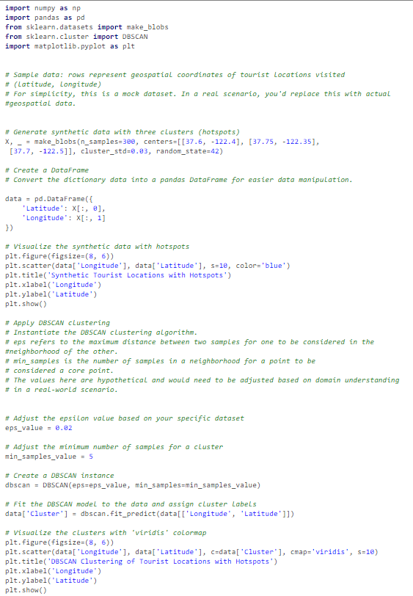
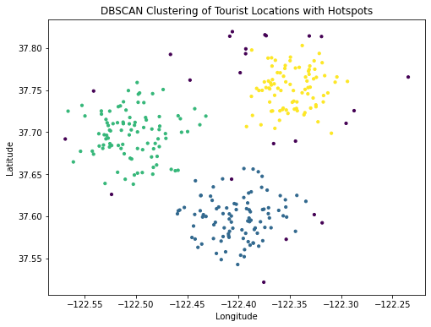
Example
Tourists' geospatial data (latitude and longitude) is collected through a mobile app as they visit various attractions in a city. Using this data, we can use DBSCAN to cluster locations to identify hotspots of tourist activity.
This script creates a hypothetical dataset of tourist locations, clusters them using DBSCAN, and visualizes the resulting clusters. Hotspots or densely visited areas will be in the same cluster, and we can identify lesser-visited spots or outliers as they will be assigned a cluster label of -1.

Slide 35
6.KMeans clustering
The objective of the K-means clustering algorithm is to find groups in the data, where data points in the same group are more similar to each other than those in other groups. The "means" in the name refers to averaging the data; that is, finding the centroid.
Here's a high-level outline of the K-means clustering algorithm:
Initialization: Choose K initial centroids, where K is the number of clusters we want. This can be done randomly or using a specific method like the K-means++ initialization.
Assignment: Assign each data point to the nearest centroid. This forms K clusters.
Update: Calculate the new centroid (mean) of each cluster.
Iteration: Repeat the assignment and update steps until the centroids do not change significantly or a certain number of iterations is reached.
The final output is a set of K centroids and a labeling of the dataset that assigns each data point to one of the K clusters.

Slide 36
Key Points to Remember
The choice of K (number of clusters) is critical. A common method to determine K is the elbow method, but there are other techniques as well.
K-means clustering aims to minimize the within-cluster variance, but it doesn't ensure an optimal global solution. This means that the result might be different based on initial centroids. Running the algorithm multiple times with different initializations can give a better idea of the optimal clustering.
K-means works best when clusters are spherical and equally sized. If clusters have different shapes or densities, other algorithms like DBSCAN or hierarchical clustering might be more appropriate.
The quality of the clustering result can be sensitive to the initialization of the centroids. The K-means++ initialization method has been proposed to improve this by ensuring a smarter initialization of the centroids.
K-means assumes that the variance of the distribution of each attribute (variable) is spherical; all variables have the same variance; and the prior probability for all k clusters is the same.
Applications of K-means include customer segmentation, image compression, anomaly detection, and many other domains where data can be grouped into distinct categories.

Slide 37
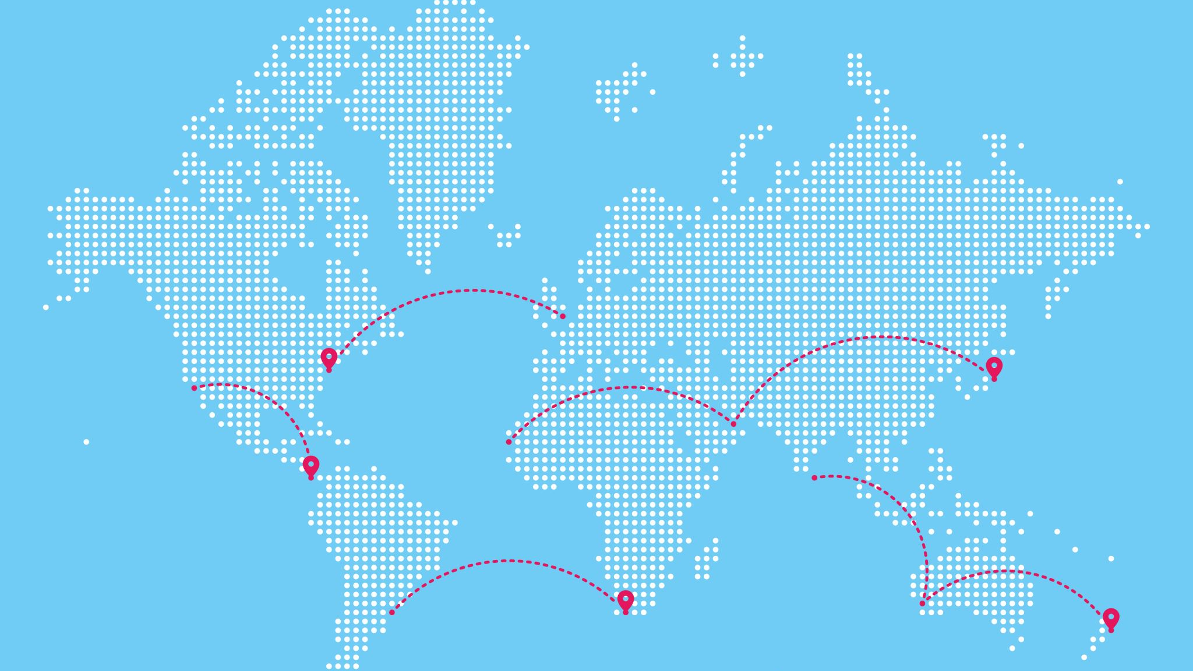
applıcatıons
Tourist Segmentation: Based on data such as preferences, previous travel history, spending habits, and social media activity, tourists can be grouped into clusters. By understanding these clusters, tourism boards and businesses can provide personalized experiences, deals, and recommendations to visitors.
Destination Clustering: Popular destinations or attractions can be clustered based on different features like type of activity (adventure, relaxation, historical), type of visitors they attract, or peak visit times. This can help in traffic management, predicting needs for amenities, and targeting specific types of tourists.
Sentiment Analysis from Reviews: By clustering reviews and feedback from platforms like TripAdvisor, businesses can identify common themes or areas of concern and address them.
Event Management: In cities or regions where multiple events occur simultaneously, clustering can help identify which events are likely to attract similar audiences. This can aid in logistics, security, and marketing.
Travel Pattern Analysis: By clustering travel patterns (like routes taken, stops made), insights can be drawn about the most popular itineraries, potential bottlenecks, or emerging hotspots.
Resource Allocation: For local governments or tourism boards, clustering can be used to determine where resources (like information kiosks, restrooms, or emergency services) should be placed for maximum utility.
Promotion and Marketing: By understanding clusters of potential travelers, marketing campaigns can be tailored to appeal to specific segments, leading to a higher return on marketing spend.
Predictive Analysis: By clustering past tourism data, predictive models can be developed to forecast future tourism trends, helping stakeholders prepare in advance.

Slide 38
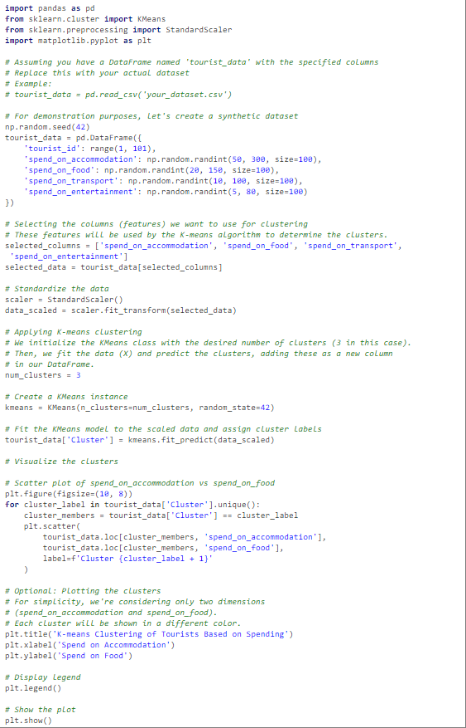
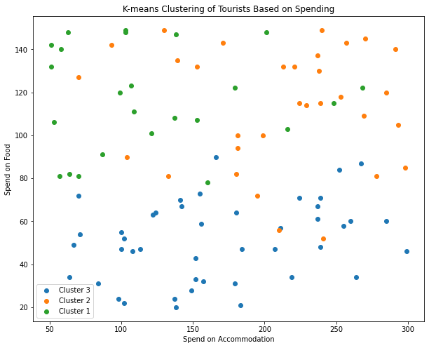
example
Assume we have a dataset with the following columns:
tourist_id: A unique identifier for each tourist.
spend_on_accommodation: Amount spent on accommodation.
spend_on_food: Amount spent on food.
spend_on_transport: Amount spent on transport.
spend_on_entertainment: Amount spent on entertainment.
We'll use the K-means algorithm from the sklearn library to cluster these tourists.
In this code, tourists are clustered into three groups based on their spending in the mentioned categories. We can adjust the number of clusters based on our analysis, for instance by using the elbow method.

Slide 39

7.Mean shift clustering
Mean shift clustering is a non-parametric, iterative algorithm used for clustering data points and for image segmentation. Unlike the popular k-means clustering which requires the number of clusters to be specified in advance, mean shift does not require prior knowledge about the number of clusters. It works by assigning each data point to the cluster whose mean is closest to it.

Slide 40
How ıt works
Initialization: Begin with an initial estimate for the mode (cluster center). This can be each data point in the dataset.
Kernel: Mean shift clustering uses a kernel (usually a Gaussian kernel) which is a weighting function. A bandwidth parameter determines the size of the kernel. A smaller bandwidth will yield more clusters, while a larger bandwidth will yield fewer clusters.
Shifting the Mean: For each data point:
Consider a window around this data point.
Compute the mean of the data within this window.
Shift the data point to the location of this mean.
Repeat until convergence.
Convergence: The algorithm terminates when the shift (movement) of all data points is below a certain threshold. Typically, points that converge close to one another are considered to be in the same cluster.
Merging: As a final step, clusters whose modes (centers) are very close to one another may be merged to form a single cluster.

Slide 41
Advantages:
It can find arbitrarily shaped clusters.
No need to specify the number of clusters in advance.
Disadvantages:
Choice of bandwidth parameter can greatly affect results.
Computationally more intensive than some other clustering algorithms like k-means.

Slide 42

applıcatıons
Personalized Recommendations: Based on the past behavior and preferences of tourists, data can be clustered to create profiles or segments of tourists. Using mean shift clustering, these segments can be dynamically adjusted without predetermining the number of segments. This allows for personalized recommendations, such as destinations, activities, or even travel packages that would most likely appeal to these segments.
Image-based Attractions Recognition: When tourists upload images to platforms or use augmented reality apps, mean shift clustering can be applied for image segmentation, which can identify different objects or attractions in the picture. Once recognized, additional information about these attractions can be provided to the tourist.
Crowd Management: Sensors and IoT devices can track the movement and density of tourists in popular destinations. Mean shift clustering can help in identifying dense clusters of tourists in real-time, helping authorities manage crowds, reduce congestion, and enhance visitor experiences.
Identifying Patterns in Feedback and Reviews: Tourists frequently leave feedback, reviews, or comments on platforms or with service providers. Mean shift clustering can help in segmenting this unstructured data to identify common sentiments or themes which can then be addressed to improve services.
Event Management: For events that attract large numbers of tourists, such as festivals or concerts, mean shift clustering can help identify patterns in attendance, preferences, or behavior. This can guide event organizers in planning better experiences, such as targeted marketing or adjusting event schedules.
Tourist Route Planning: By analyzing the GPS data of tourists, mean shift clustering can be used to identify popular routes, stops, and patterns in tourist movement. This information can help in designing more effective and enjoyable tour routes.

Slide 43
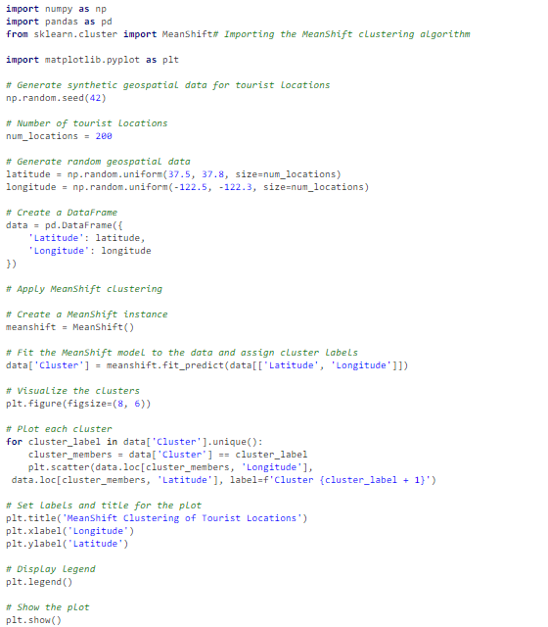
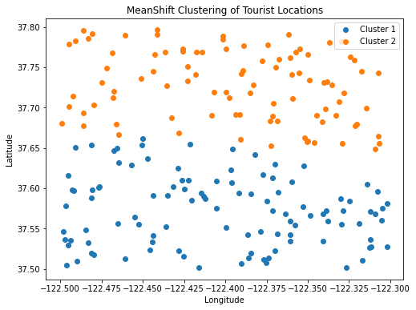
example
By using the MeanShift clustering from the sklearn library. This example clusters tourist locations based on their latitude and longitude. The goal is to identify areas of interest where tourists tend to visit the most.
Let's imagine a dataset where we have the coordinates of various tourist attractions or places tourists visited in a city
This example uses dummy data, but in a real-world scenario, we might pull the location data from a database, an API, or other sources.
Here, the locations of tourist attractions or activities are clustered based on proximity. The identified cluster centers can be considered areas with a high density of tourist attractions or activities.

Slide 44
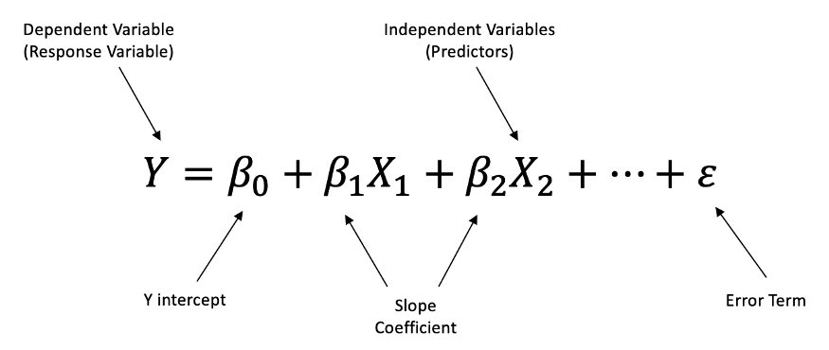
8.Multiple Linear Regression
Multiple Linear Regression (MLR) is an extension of simple linear regression that predicts a dependent variable based on more than one independent variable. Essentially, while simple linear regression uses a single predictor to model a relationship with a response variable, multiple linear regression uses two or more predictors. The formula for a multiple linear regression is:
Where:
Y is the dependent variable (the variable we are trying to predict).
Β₀ is the y-intercept.
B₁,B₂,B₃,…….,B_{p} are the coefficients of the independent variables X₁,X₂…….X_{p} respectively. These coefficients indicate the change in Y for a one-unit change in the respective independent variable, holding all other predictors constant.
ϵ represents the residual error, i.e., the difference between the observed value and the predicted value for each data point.

Slide 45

Key poınts
Assumptions: MLR makes several assumptions, including linearity (the relationship between the independent and dependent variables is linear), independence (the residuals are independent), homoscedasticity (the residuals have constant variance), and normality (the residuals are normally distributed).
Multicollinearity: One important consideration in MLR is the presence of multicollinearity, which occurs when two or more independent variables are highly correlated. This can distort the coefficients and make them unreliable. Techniques like Variance Inflation Factor (VIF) can be used to detect multicollinearity.
Model Fit: The goodness of fit of the model can be assessed using metrics like R-squared, which explains the proportion of the variance in the dependent variable that's predicted from the independent variables.
Model Complexity: Adding more variables to a multiple linear regression model can make the model more complex, and it doesn't always lead to a better fit. Model selection techniques, like backward elimination, forward selection, and stepwise regression, can be used to select the right subset of variables.
Applications: MLR can be applied in various fields such as economics, finance, social sciences, and many other areas where relationships between variables need to be explored and quantified.

Slide 46
applıcatıons
Predicting Tourist Arrivals: By using predictors such as historical data, economic indicators, marketing budgets, and even weather patterns, MLR can help in forecasting the number of tourists expected in a particular region or attraction.
Tourist Spending Analysis: MLR can be used to model how various factors like tourist demographics, duration of stay, purpose of travel, and attraction ratings influence the amount a tourist is likely to spend.
Optimizing Marketing Campaigns: By modeling the effectiveness of various marketing channels (social media, TV, print, etc.) on tourist arrivals or spending, tourism boards and companies can better allocate their budgets.
Evaluating Impact of Events: By analyzing data before and after major events (like festivals, sports events, etc.), MLR can help determine the economic impact of these events on tourism.
Resource Allocation: For cities or regions expecting an influx of tourists, MLR can help in predicting which amenities or services (like public transport, sanitation, security) might face more demand, based on factors such as the type of tourists arriving, their historical behavior, and scheduled events.
Tourist Satisfaction Analysis: Using feedback and reviews, MLR can help understand the factors most contributing to tourist satisfaction, which can then guide service improvements.
Environmental Impact Analysis: With sustainability becoming crucial in tourism, MLR can help model the impact of tourist numbers on local environments using variables such as waste production, water usage, and carbon emissions.
Personalized Offers and Packages: By modeling tourist preferences based on historical data, demographics, and feedback, MLR can be used to craft personalized tour packages or offers.

Slide 47
Python Library/s
Scikit-learn (sklearn): Provides LinearRegression for this purpose.
Example: from sklearn.linear_model import LinearRegression
Statsmodels (statsmodels): Another library to perform linear regression and explore detailed statistics related to the model.

Slide 48
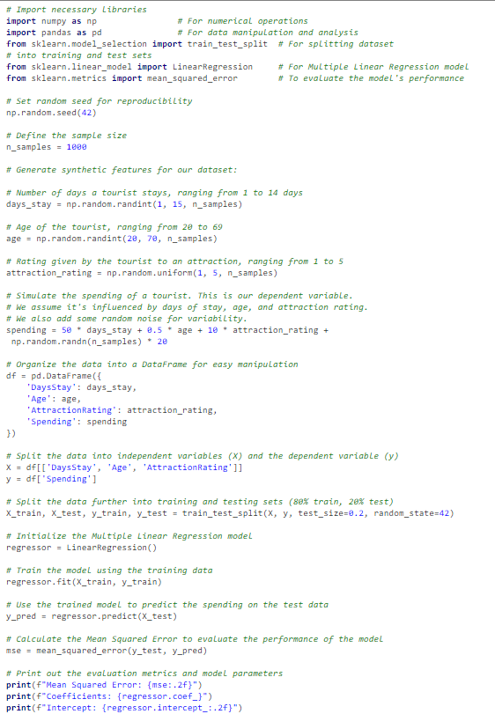
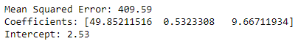
example
Here is the python code where we want to predict tourist spending based on various factors such as the number of days they stay, their age, and ratings they give to local attractions.
For simplicity, we'll create a synthetic dataset using numpy and then apply Multiple Linear Regression using scikit-learn.
This code first generates a synthetic dataset where tourist spending is influenced by the number of days they stay, their age, and the ratings they give to attractions. The relationship is linear with some random noise added for realism.
The LinearRegression model from scikit-learn is then trained on this data, and the model's performance is evaluated using the Mean Squared Error on a test set.

Slide 49
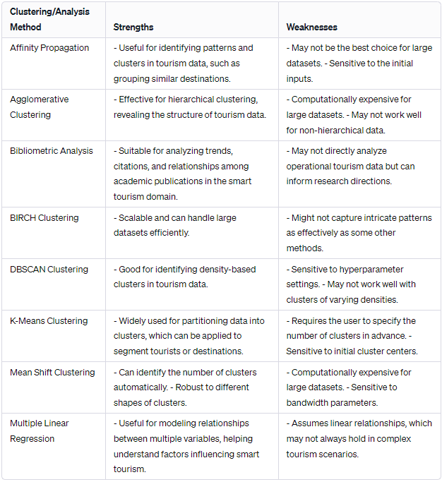
comparıson

Slide 50

Affinity Propagation: Strengths: Can be useful for identifying patterns and clusters in tourism data, such as grouping similar destinations. Weaknesses: May not be the best choice for large datasets, and it can be sensitive to the initial inputs.
Agglomerative Clustering: Strengths: Effective for hierarchical clustering and revealing the structure of tourism data. Weaknesses: Computationally expensive for large datasets and may not work well for non-hierarchical data.
Bibliometric Analysis: Strengths: Suitable for analyzing trends, citations, and relationships among academic publications in the smart tourism domain. Weaknesses: May not directly analyze operational tourism data but can inform research directions.
BIRCH Clustering: Strengths: Scalable and can handle large datasets efficiently. Weaknesses: Might not capture intricate patterns as effectively as some other methods.
DBSCAN Clustering: Strengths: Good for identifying density-based clusters in tourism data. Weaknesses: Sensitive to hyperparameter settings and may not work well with clusters of varying densities.
K-Means Clustering: Strengths: Widely used for partitioning data into clusters, which can be applied to segment tourists or destinations. Weaknesses: Requires the user to specify the number of clusters in advance and is sensitive to initial cluster centers.
Mean Shift Clustering: Strengths: Can identify the number of clusters automatically and is robust to different shapes of clusters. Weaknesses: Computationally expensive for large datasets and sensitive to bandwidth parameters.
Multiple Linear Regression: Strengths: Useful for modeling relationships between multiple variables, which can help understand factors influencing smart tourism. Weaknesses: Assumes linear relationships, which may not always hold in complex tourism scenarios.

Slide 51

Comparison of data analytic techniques
The choice of data analytic techniques in the field of smart tourism largely depends on the specific goals and nature of our analysis. Different techniques have different strengths and weaknesses, and their suitability can vary depending on the type of data, the research questions we want to address, and the desired outcomes.

Slide 52
Analysis Method | Strengths | Weaknesses
Affinity Propagation | Can be useful for identifying patterns and clusters in tourism data, such as grouping similar destinations. | May not be the best choice for large datasets, and it can be sensitive to the initial inputs.
Agglomerative Clustering | Effective for hierarchical clustering and revealing the structure of tourism data. | Computationally expensive for large datasets and may not work well for non-hierarchical data.
Bibliometric Analysis | Suitable for analyzing trends, citations, and relationships among academic publications in the smart tourism domain. | May not directly analyze operational tourism data but can inform research directions.
BIRCH Clustering | Scalable and can handle large datasets efficiently. | Might not capture intricate patterns as effectively as some other methods.
DBSCAN Clustering | Good for identifying density-based clusters in tourism data. | :Sensitive to hyperparameter settings and may not work well with clusters of varying densities.
K-Means Clustering | Widely used for partitioning data into clusters, which can be applied to segment tourists or destinations. | Requires the user to specify the number of clusters in advance and is sensitive to initial cluster centers.
Mean Shift Clustering | Can identify the number of clusters automatically and is robust to different shapes of clusters. | Computationally expensive for large datasets and sensitive to bandwidth parameters.
Multiple Linear Regression | Useful for modeling relationships between multiple variables, which can help understand factors influencing smart tourism. | Assumes linear relationships, which may not always hold in complex tourism scenarios.

Slide 53
Briefly, to determine which technique is more useful for smart tourism, we should consider the specific objectives of our analysis. For instance, if we want to identify tourist preferences and segment tourists, clustering methods like K-Means or DBSCAN may be suitable. If we're looking to understand the influence of various factors on tourism outcomes, multiple linear regression could be more appropriate. A combination of techniques may also be used to gain a comprehensive understanding of the data.

Slide 54
Thank you

